Slide 1
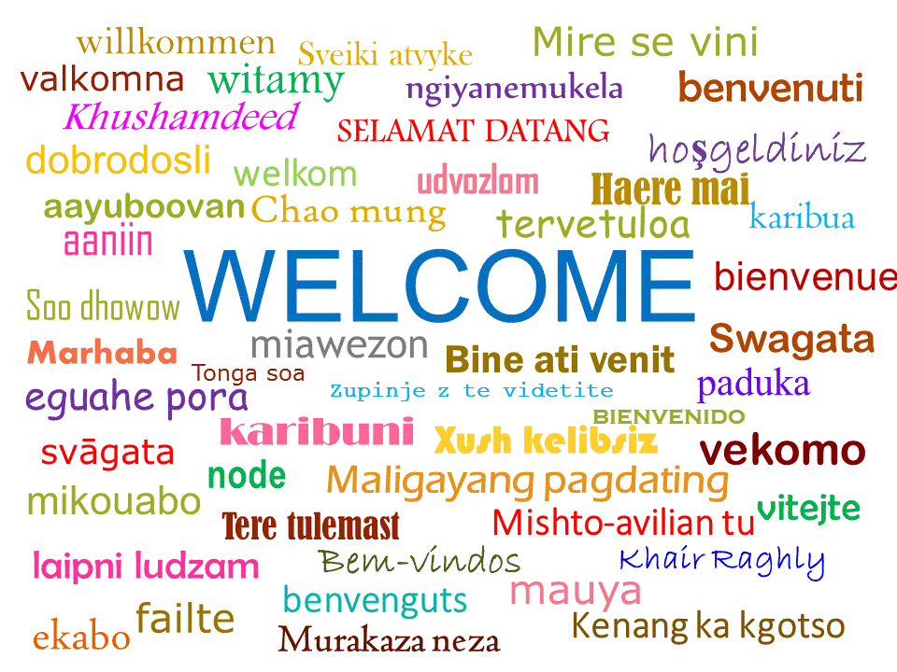
+ online

Slide 2
Let’s introduce ourselves
Cyril Crevoisier, LMD/CNRS, ISSWG co-chair
Pierre-François Coheur, ULB, ISSWG co-chair
Laura Le Barbier, CNES, ISSWG co-secretary
Thomas AUGUST, EUMETSAT, ISSWG co-secretary
Gabriele Kerrmann, EUMETSAT, Organisation committee
Sylvie Berger, CNES, Organisation committee
Anaïs, Audrey, Meghan, Insight & Outside – Onsite & Registrations
Elodie, Romain, Prodigima – Virtual Conference
IASI/IASI-NG Sounding Science Working Group – Scientific Committee
Carmine Serio, University of Basilicata
Cathy Clerbaux, LATMOS
Chawn Harlow, UKMO
Claude Camy-Peyret, IPSL
Jérôme Vidot, Météo-France
Laurent Labonnote, LOA
Marco Matricardi, ECMWF
Nadia Fourrie, Meteo-France
Raymond Armante, LMD
Reima Eresmaa, ECMWF
Robert Knuteson, U. Wisconsin Madison
Robin Faulwetter, DWD
Zsofia Kocsis, OMSZ
Vincent Guidard, Météo-France
Antonia Gambacorta, NASA

Slide 3
IASI Conference
CNES and EUMETSAT
IASI/IASI-NG Science Working Group (ISSWG)
Gather the worldwide IASI community
Instruments & Science experts
Users : Operational and Academia
Compile, present and discuss latest advances
Maximise utilisation of IASI, scout new applications
Feed-back to missions, products & services
Prepare the New Generation: IASI-NG

Slide 4
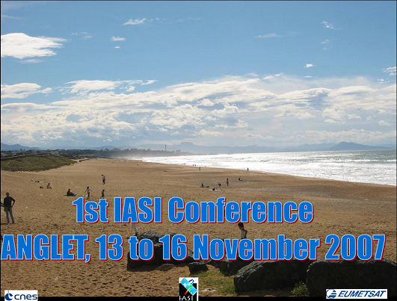
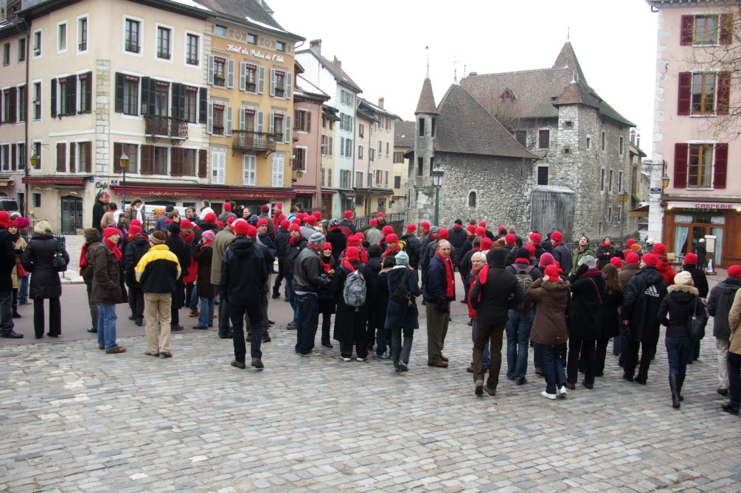
A (very) brief history of the IASI Conferences
November 2007, Anglet
1 year after mission launch
Instrument performance, scientific perspectives
January 2010, Annecy
Consolidated results
Significant impact in NWP
February 2013, Hyères
Atmospheric Composition rising
IASI/Metop-B, first instrument perfo results
April 2016, Antibes - IASI is turning 10
Atmospheric Composition
Climate perspective
2 IASI in Space

Slide 5
A (very) brief history of the 5th IASI Conference
20-24 April 2020 - Evian
14 years and 3 IASIs in space
1
3-7 May 2021 - Evian
14.5 years and 3 IASIs in space
6-10 Dec 2021 - Evian
15 years and 2 IASIs in space
+ online
Still 95 onsite
till 26/11/2021
Oh my crown - variant

Slide 6
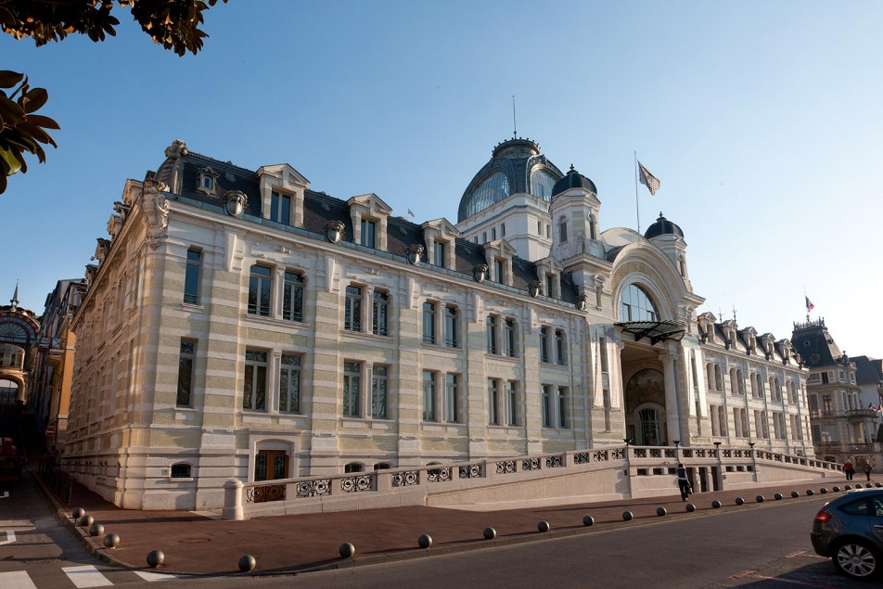
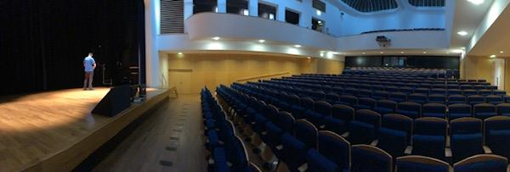
Hybrid Onsite - Online conference
Live stream presentations
Interactive Q&A online
Links emailed
Agility
Patience
Enthusiasm
Good science and exchanges!!!

Slide 7
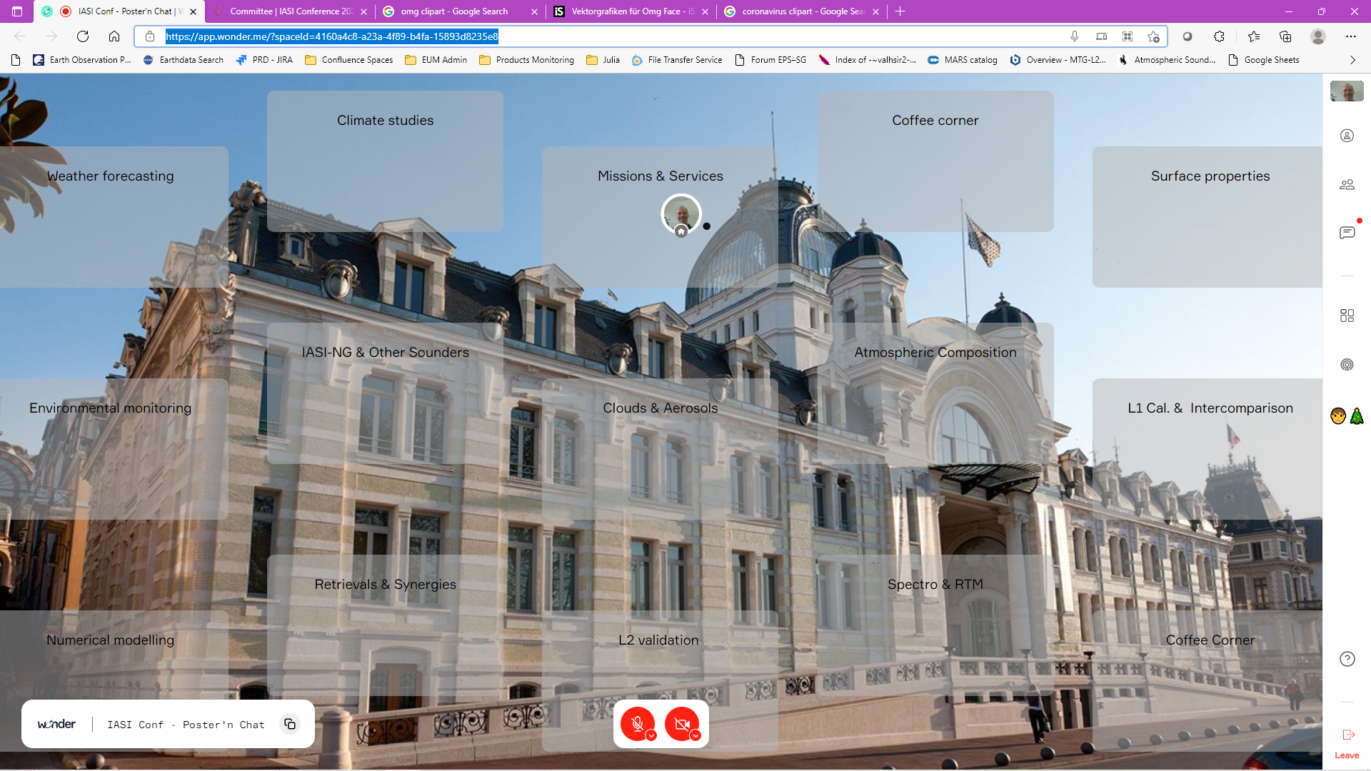
5th IASI Conference – Online
Poster, Meet’n Chat – Wonder area
Link available on the
IASI 2021 website

Slide 8
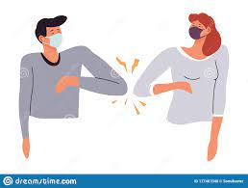
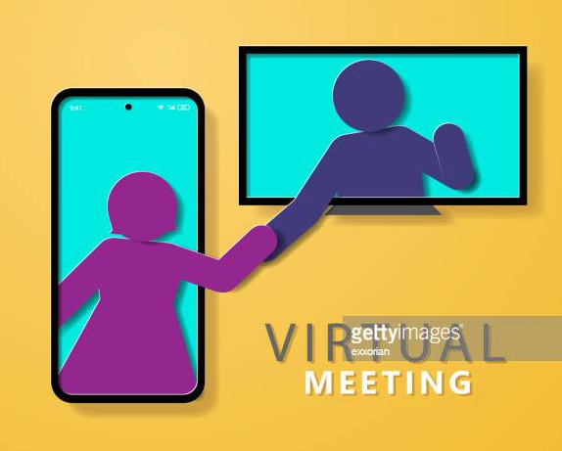
73” to Greet your neighbour
and
the 1st-timers to the IASI-conference

Slide 9
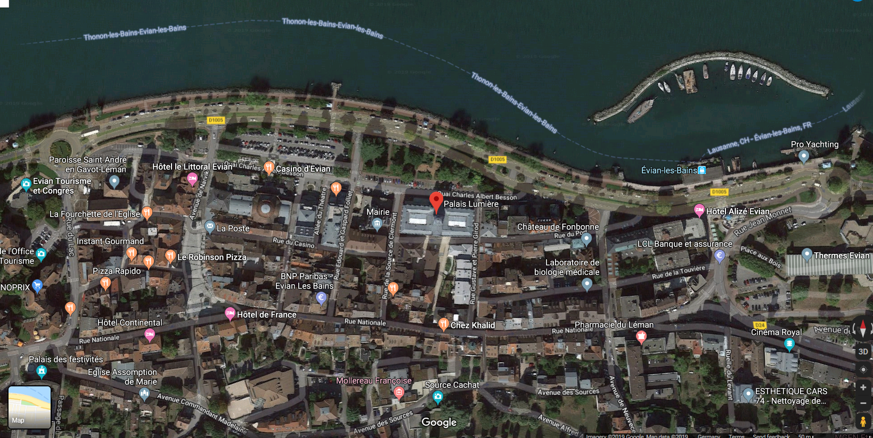
Palais Lumières
Pedestrian area
hotels, restaurants,
shops, pharmacy…

Slide 10
Dining in town
La Fabrik: Home cook - Organic and local-supply oriented
Zaino: Nice Italian restaurant
Instant Gourmand: House cook , small, booking necessary
Bureau: next to Casino. Kitchen open 7/7 until 01:00
Au Jardin d’Eden: Michelin, higher standard
… and many more …
All within the pedestrian area
Supermarket
Franprix: 1 blocks away from the conference centre – Mo-Sa 07:30-21h00 Su 09:00-13:00
Monoprix: West end of the Rue Nationale – Mo-Sa 09:30-19h00
Terre Bio: Organic food shop – Mo-Sa 09:00-12:30 & 14:00-19:00
Local shopping
La ferme du noyer: local cheese, local wine, smoked ham & saucissons
L’espace Evian: Mineral water musuem + souvenirs shop
Palais Lumières: Art exhibition and … 5th IASI Conference
… and many more …

Slide 11
Scientific program
IASI turning 15 !
3 instruments exploited in space
NWP: more pixels, more spectral info, PCA, assimilation in clouds...
AC/AQ: 25+ species, from detection to environmental monitoring
New operational services (global, regional, climate)
Growing pool of users
Entering the Climate club
IASI anchor for IR calibration
Highlights 2020 ➔ get ready for Highlights 2021!
and many more...

Slide 12
Scientific program
About 120 abstracts submitted from Europe and USA
Initial program: 59 talks, 60 posters, in the following sessions:
IASI missions & services | Atmospheric composition
Weather forecasting | Cloud & Aerosols
Climate studies | Environmental monitoring
IASI-NG | L1 Calibration & Intercomparison
Other IR sounders | L2 Validation & campaigns
Spectroscopy & radiative transfer | Retrieval techniques & synergies
Surface properties | AC/AQ numerical modelling

Slide 13
Scientific program
Practical aspects
Topical blocks
Series of talks: 14’ talk + questions onsite & online
Posters introduction:
1-minute pitch with one slide.
Kindly line up by the stage when your turn comes.
Dedicated poster time: around lunch time and in the afternoon coffee
onsite: stand by your poster
online: Wonder-area, engage discussion and share your screen
ample time for good discussions
Best posters & talk in conf
Session chairs, please introduce yourselves when opening your session

